Slide 1
Missed Opportunity Dashboard
Analyzing Potential Revenue Loss Due to Delays and Operational Inefficiencies
Notes:
Open with the problem statement: damage and delays erode trust and add cost; this analysis quantifies drivers and prioritizes actions.

Slide 2
Business Context & Problem
• Lead-driven businesses depend heavily on timely responses and effective follow-ups
• Delays in responding to leads result in lost conversions
• Operational inefficiencies cause significant revenue leakage
Notes:
Mention report pages: Executive summary, Damage, Delay, Risk/Actions, Drillthrough for evidence.

Slide 3
Business Model
• Lead-based B2B service / SaaS-oriented sales model
• Leads generated through digital and referral channels
• Sales teams convert leads through engagement and follow-ups
• Response time is a critical success factor
Notes:
Tie to cost avoidance and customer experience; emphasize measurable targets and drillthrough verification.

Slide 4
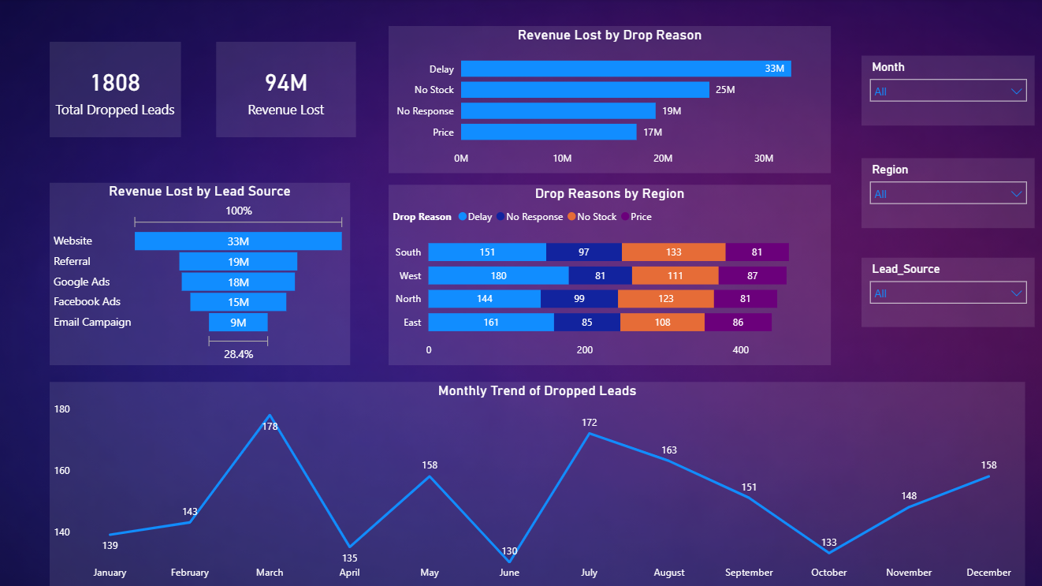
Analytical Objectives
• Identify revenue loss caused by dropped leads
• Identifying the revenue loss by Lead source
• Identifying which region has the most drops

Slide 5
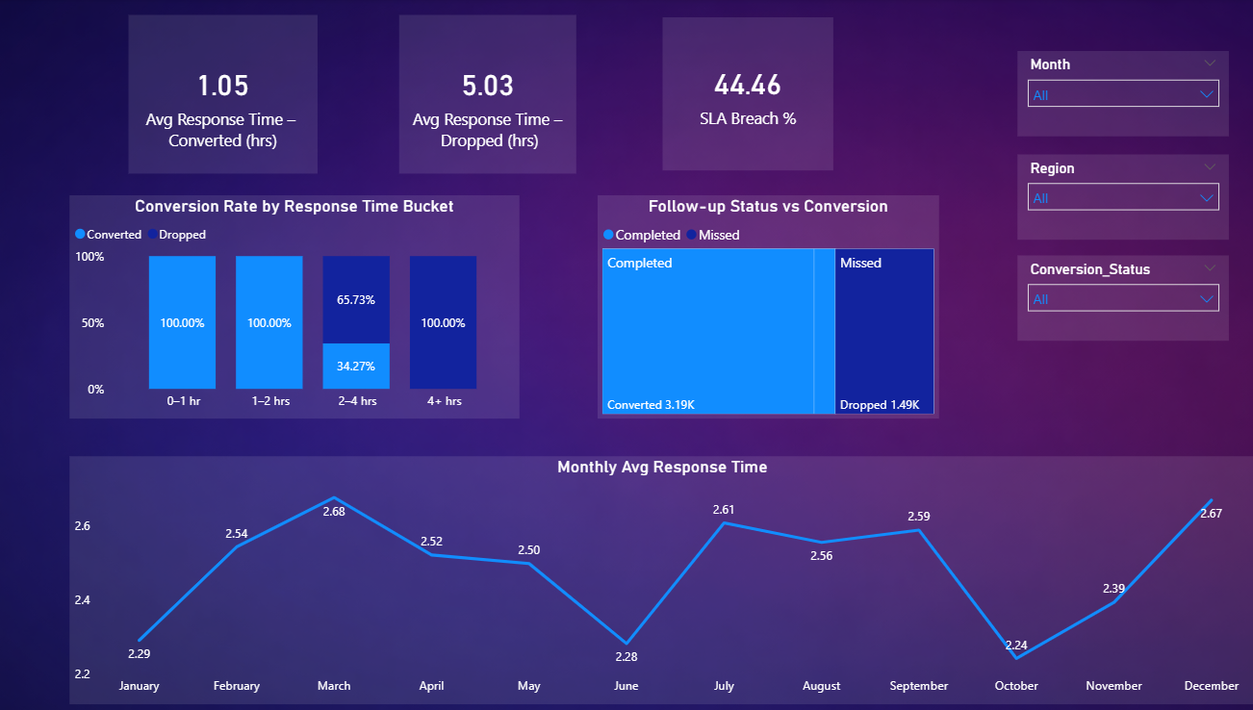
Executive Insights Summary
• Conversion is good in the first 1-2 hours
• Conversion probability declines sharply after 4+ hours of response delay
• Follow-ups increase the chances of conversions

Slide 6
Recommendations & Conclusion
• Enforce strict response-time SLAs (≤ 2 hours)
• Prioritize faster handling of high-value lead sources
• Strengthen follow-up discipline within sales teams
• Continuous monitoring of response time can significantly reduce revenue loss
Notes:
Close with the operational playbook and the expected KPI lift.

